Slide 1


NBA PLAYER STATISTICAL ANALYSIS AND PREDICTION PROJECT
COLLABORATORS
JACOB EVANS
KARAN ANAND
MERT OZTOP
PRATIK PUROHIT
PRIYA MARINGANTI

Slide 2

OVERVIEW
Our goal in this project was to attempt to predict the points for basketball player for the upcoming season using machine learning techniques.

Slide 3

METHODOLOGY
Data Collection
Data Preprocessing
Exploratory Data Analysis
Model Training and Evaluation

Slide 4
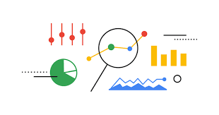
DATA SOURCES
NBA Stats : Kaggle (2021/22 & 2022/23)
Athlete Head Shot: WebScraping (NBA Website and Loodibees Logos)

Slide 5
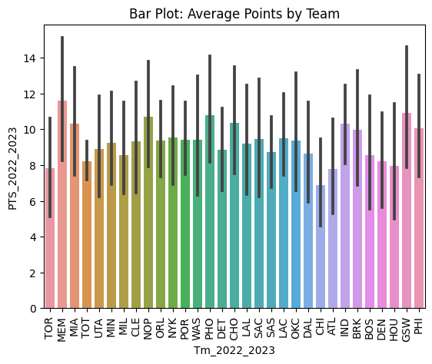
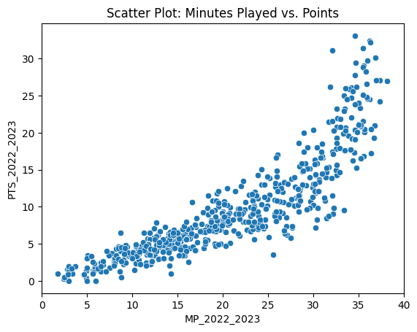
DATA ON s3 AWS
Exploratory Data Analysis
Barplot of Average Points by Team for 2022/2023
ScatterPoints for Minutes Played vs. Points

Slide 6

Model Training & Evaluation
Experimented with various regression: linear regression, decision tree regression, random forest regression, and lasso model.
The Linear regression model was our best choice because it showed the least MSE.
Model | R-Squared | Mean Square Error
Linear Regression | 0.9988 | 0.077
Random Forest Regression | 0.9987 | 0.548
Random Decision Tree | 1.0 | 1.041
Lasso Model Regression | 0.9982 | 0.256

Slide 7
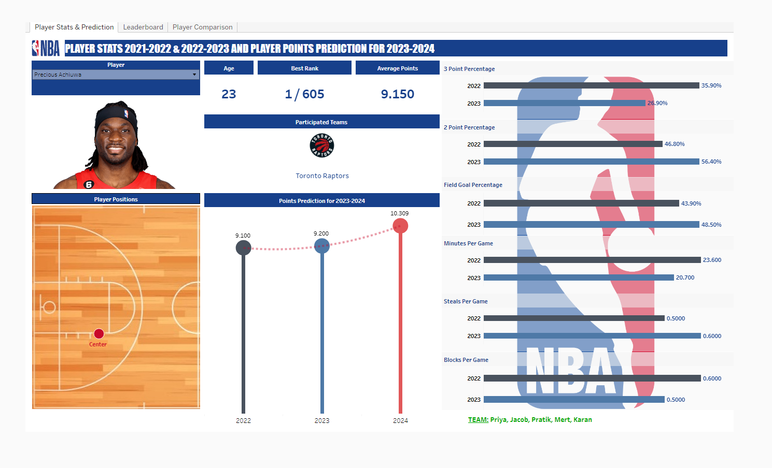
User Interface
Player Stats and Prediction

Slide 8
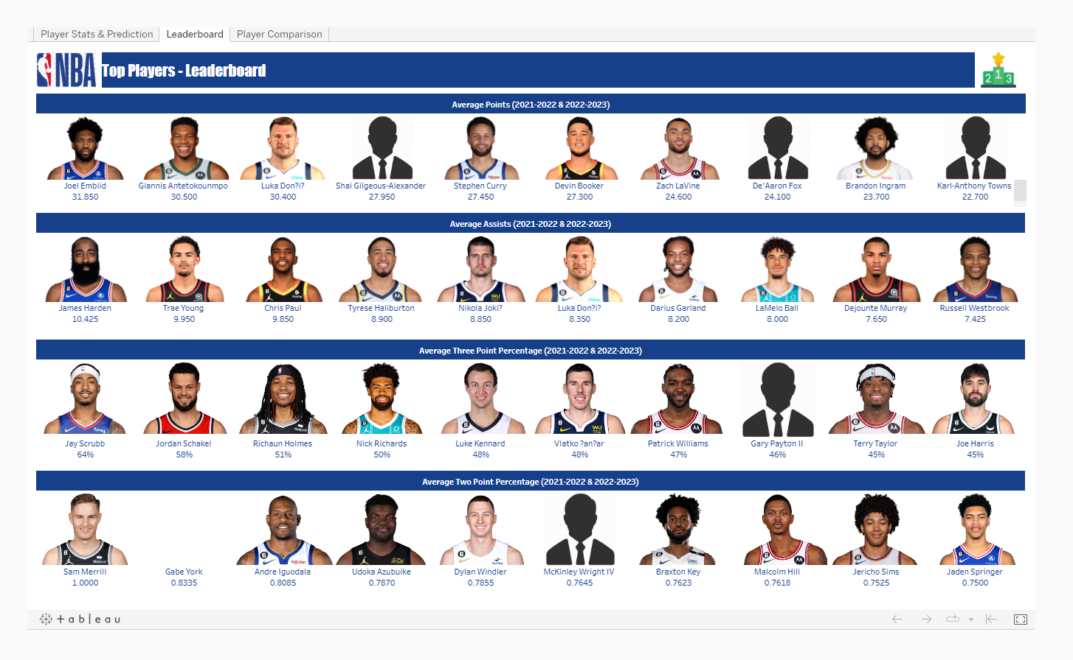
User Interface
Player Stats and Prediction

Slide 9
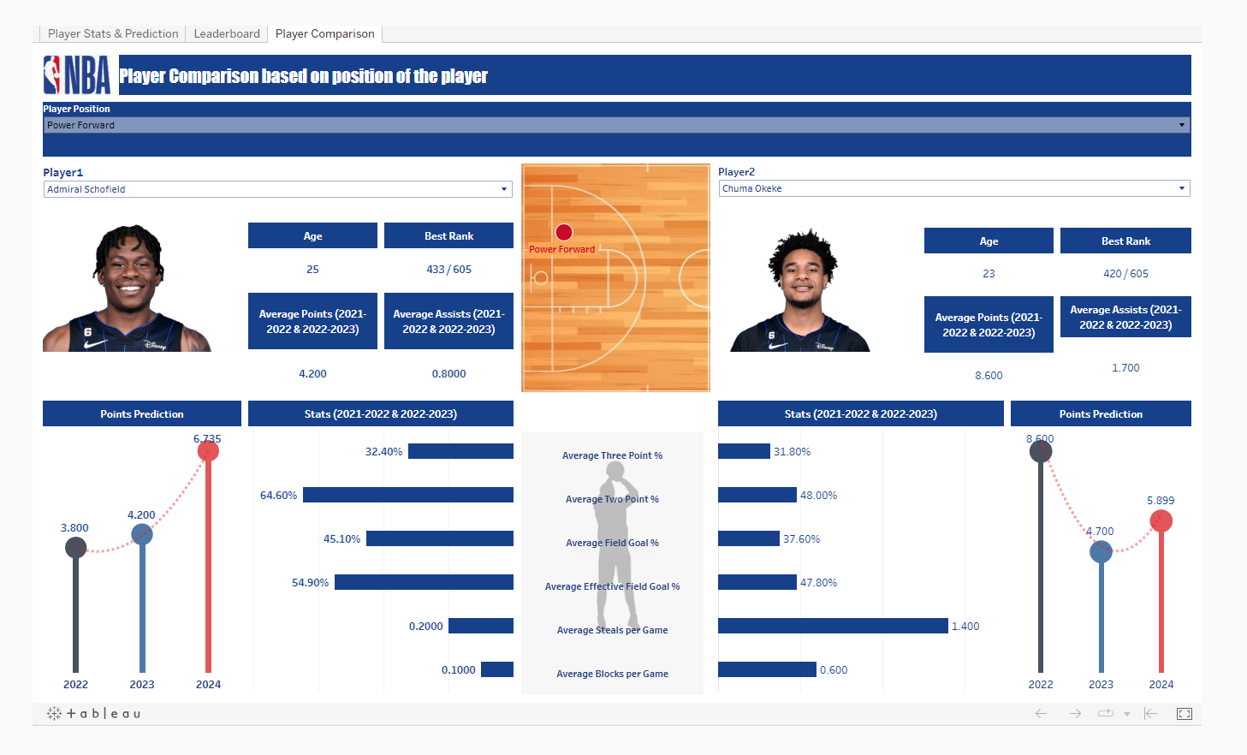
User Interface
Player Comparison

Slide 10

RESULT
The prediction system achieved R-squared value of 0.9998, indicating a high level of accuracy in predicting player statistics based on the historical data.
The system can assist with team selection, player scouting, and forecasting player statistics for the upcoming season.

Slide 11

CHALLENGES
Bad Encoding
External factors
Outliers

Slide 12

THANK YOU
QUESTIONS ARE WELCOME

